Slide 1
192.168.10.25
210.1.2.3
Web Browser
Port 1025
Web Server
Port 80
Router
Your
Computer
SSH Client
Port 1026
150.1.2.3
SSH Server
Port 22
Servers
DNS Client
Port 1027
8.8.8.8
DNS Server
Port 53
Connections, or Flows
192.168.10.25:1025 – 210.1.2.3:80
192.168.10.25:1026 – 150.1.2.3:22
192.168.10.25:1027 – 8.8.8.8:53

Slide 2
TCP vs UDP
TCP (“reliable”)
Every packet has a sequence number (like a serial number)
Missing packets are requested again
Out of order packets put in proper order
Lots of overhead
Used where it is important not to miss a packet (ex.: file download)
UDP (“unreliable”)
No sequence number, no requesting missing packets, no re-ordering
Little overhead
Used where you can miss a few packets (streaming) or just do the request again (DNS)

Slide 3
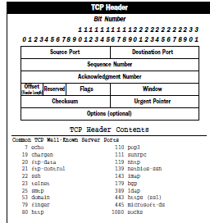
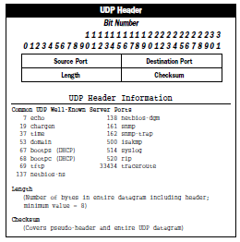
TCP and UDP headers

Slide 4
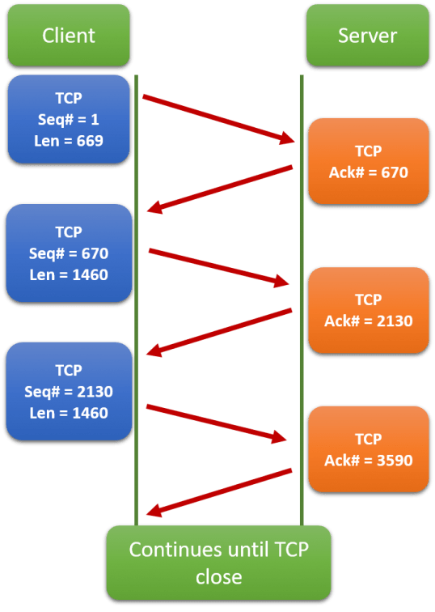
TCP Sequence and Acknowledgement numbers
(only showing one direction)

Slide 5
